Slide 1

Built-In Functions Of SQL

Slide 2
Objective Of Built-In Function
With the help of built in function we can use math function,string function,Datetime function easily.
With the help of this we can format our output.
Get the datetime function easily.and also know the current user of system easily.
User-Defined Functions that allow you to define your own T-SQL functions that can accept zero or more parameters and return a single scalar data value or a table data type.

Slide 3
Types Of Built-In functions
There are two types of built-in function.
      Standard Built-in Functions
      Aggregates Functions (Set Functions)

Slide 4
Standard Built-in Functions
Numeric Functions

Slide 5
Standard Built-in Functions
ABS or ABSVAL
  ABS or ABSVAL returns the absolute value of a numeric expression.
  The return type is the type of parameter.
  All built-in numeric types are supported (DECIMAL, DOUBLE PRECISION, FLOAT, INTEGER, BIGINT, NUMERIC, REAL, and SMALLINT).
  Syntax
  ABS(NumericExpression)
  VALUES ABS(-3)
  returns 3

Slide 6
Standard Built-in Functions(Cont.)
ROUND Function
  Returns the number rounded to the precision specified by length. If length is positive, the digits to the right of the decimal point are rounded. If it's negative the digits to the left of the decimal point are rounded. To truncate the number rather than round it code a non zero value for function.
  Syntax
  ROUND(number, length, [function])
  SELECT ROUND(123.9994, 3);
  --returns
  123.9990

Slide 7
Standard Built-in Functions(Cont.)
ISNUMERIC Function
  Returns a value of 1 (true) if the expression is a numeric value; returns a values of 0 (false) otherwise.
  Syntax
  ISNUMERIC (expressions)
  SELECT IsNumeric(1);
  --returns 1
  SELECT ISNumeric('Monal');
  --returns 0

Slide 8
Standard Built-in Functions(Cont.)
SQUARE Function
  Returns the square of the given expression.
  Syntax
  SQUARE (expression)
  SELECT SQUARE(2);
  --returns
  4

Slide 9
Standard Built-in Functions(Cont.)
RAND Function
  Returns a random float value from 0 through 1.
  Seed
  Is an integer expression (tinyint, smallint, or int) that specifies the seed value. If seed is not specified, Microsoft SQL Server 2000 assigns a seed value at random. For a given seed value, the result returned is always the same.
  Syntax
  RAND ([seed])
  SELECT RAND() ;
  --returns
  0.924370319166178

Slide 10
Standard Built-in Functions(Cont.)
SQRT Function
  Returns the square root of a floating point number; only the built-in types REAL, FLOAT, and DOUBLE PRECISION are supported. The return type for SQRT is the type of the parameter.
  Note: To execute SQRT on other data types, you must cast them to floating point types.
  Syntax
  SQRT(FloatingPointExpression)
  SELECT SQRT(3421E+09);
  --returns
  1849594.55016498
  SELECT SQRT (CAST(25 AS FLOAT));
  --returns
  5

Slide 11
Standard Built-in Functions(Cont.)
CEILING Function
  The CEIL and CEILING functions round the specified number up, and return the smallest number that is greater than or equal to the specified number.
  The specified number must be a DOUBLE PRECISION number.
  If the specified number is NULL, the result of these functions is NULL.
  If the specified number is equal to a mathematical integer, the result of these functions is the same as the specified number.
  If the specified number is zero (0), the result of these functions is zero.
  If the specified number is less than zero but greater than -1.0, then the result of these functions is zero.
  CEILING ( number )
    Select ceiling(15.59)
      Output
        16

Slide 12
Standard Built-in Functions(Cont.)
Floor Function
  The FLOOR function rounds the specified number down, and returns the largest number that is less than or equal to the specified number.
  Syntax
  SELECT Floor(25.95);
  --returns
  25

Slide 13
Standard Built-in Functions(Cont.)
MATH Function

Slide 14
Standard Built-in Functions(Cont.)
ACOS Function
  The ACOS function returns the arc cosine of a specified number.
  The specified number is the cosine, in radians
  If the specified number is NULL, the result of this function is NULL.
  If the absolute value of the specified number is greater than 1, an exception is returned that indicates that the value is out of range (SQL state 22003).
  The returned value, in radians, is in the range of zero (0) to pi. The data type of the returned value is a DOUBLE PRECISION number.
  Syntax
  ACOS ( number )
    SELECT ACOS(0.20)
  Output
  1.36943840600457

Slide 15
Standard Built-in Functions(Cont.)
ASIN Function
    The ASIN function returns the arc sine of a specified number.
    The specified number is the sine, in radians.
    The specified number must be a DOUBLE PRECISION number.
    If the specified number is NULL, the result of this function is NULL.
    If the specified number is zero (0), the result of this function is zero with the same sign as the specified number.
    If the absolute value of the specified number is greater than 1, an exception is returned that indicates that the value is out of range (SQL state 22003).
    The returned value, in radians, is in the range -pi/2 to pi/2. The data type of the returned value is a DOUBLE PRECISION number.
    Syntax
    ASIN ( number )
    SELECT ASIN(0.20)
  Output
        0.201357920790331

Slide 16
Standard Built-in Functions(Cont.)
ATAN Function
  The ATAN function returns the arc tangent of a specified number.
  The specified number is the tangent, in radians, of the angle that you want. The specified number must be a DOUBLE PRECISION number.
  If the specified number is NULL, the result of this function is NULL.
  If the specified number is zero (0), the result of this function is zero with the same sign as the specified number.
  The returned value, in radians, is in the range -pi/2 to pi/2. The data type of the returned value is a DOUBLE PRECISION number.
  Syntax
  ATAN ( number )
    SELECT ATAN(0.20)
  Output
    0.197395559849881

Slide 17
Standard Built-in Functions(Cont.)
CAST Function
  The CAST function converts a value from one data type to another and provides a data type to a dynamic parameter (?) or a NULL value.
  CAST expressions are permitted anywhere expressions are permitted.
  Syntax
  CAST ( [ Expression | NULL | ? ] AS Datatype) The data type to which you are casting an expression is the target type. The data type of the expression from which you are casting is the source type.
Conversions from numeric types
  For example, casting 763.1234 as INTEGER yields 763.
Conversions from and to bit strings
  Bit strings can be converted to other bit strings, but not character strings .
Conversions of date/time values
  A date/time value can always be converted to and from a TIMESTAMP
  (CAST (CURRENT_TIMESTAMP AS VARCHAR(100)))
Conversions of XML values
  An XML value cannot be converted to any non-XML type using an explicit or implicit CAST. Use the XMLSERIALIZE operator to convert an XML type to a character type.

Slide 18
Standard Built-in Functions(Cont.)
Concatenation Function
  The concatenation operator, +, concatenates its right operand to the end of its left operand. It operates on a character or bit expression.
  Because all built-in data types are implicitly converted to strings, this function can act on all built-in data types.
  Syntax
  { { CharacterExpression + CharacterExpression } | { BitExpression + BitExpression } }
Examples:
  --returns 'supercalifragilisticexbealidocious(sp?)‘
  VALUES 'supercalifragilistic‘+'exbealidocious‘+'(sp?)'
  -- returns NULL VALUES
  CAST (null AS VARCHAR(7))+'AString‘
  -- returns '130asdf‘
  VALUES '130‘+'asdf'

Slide 19
Standard Built-in Functions(Cont.)
COS Function
  The COS function returns the cosine of a specified number.
  The specified number is the angle, in radians, that you want the cosine for. The specified number must be a DOUBLE PRECISION number.
  If the specified number is NULL, the result of this function is NULL.
  Syntax
  COS ( number )
  Select COS(0.20);
  --Returns 0.980066577841242

Slide 20
Standard Built-in Functions(Cont.)
DEGREES Function
  The DEGREES function converts a specified number from radians to degrees.
  The specified number is an angle measured in radians, which is converted to an approximately equivalent angle measured in degrees. The specified number must be a DOUBLE PRECISION number.
  Attention: The conversion from radians to degrees is not exact. You should not expect that the COS(RADIANS(90.0)) to exactly equal 0.0.
  The data type of the returned value is a DOUBLE PRECISION number.
  Syntax
  DEGREES ( number )
  SELECT DEGREES(25.65);
  --returns
  1469.636744510561600000

Slide 21
Standard Built-in Functions(Cont.)
EXP Function
  The EXP function returns e raised to the power of the specified number.
  The specified number is the exponent that you want to raise e to. The specified number must be a DOUBLE PRECISION number.
  The constant e is the base of the natural logarithms.
  The data type of the returned value is a DOUBLE PRECISION number.
  Syntax
  EXP ( number )
  SELECT EXP(4);
  --returns
  54.5981500331442

Slide 22
Standard Built-in Functions(Cont.)
LOG Function
  LOG functions return the natural logarithm (base e) of the specified number.
  Syntax
  LOG(numericvalue);
  Select Log(2);
  --returns
  0.693147180559945

Slide 23
Standard Built-in Functions(Cont.)
LOG10 Function
  The LOG10 function returns the base-10 logarithm of the specified number.
  Syntax
  LOG10(numericvalue)
  Select LOG10(2);
  --returns
  0.301029995663981

Slide 24
Standard Built-in Functions(Cont.)
MOD(%) Function
  MOD returns the remainder (modulus) of argument 1 divided by argument 2. The result is negative only if argument 1 is negative.
  Syntax
  Select (10%2);
  --returns
  0

Slide 25
Standard Built-in Functions(Cont.)
PI Function
  The PI function returns a value that is closer than any other value to pi.
  The constant pi is the ratio of the circumference of a circle to the diameter of a circle.
  Syntax
  PI()
  Select PI();
  --returns
  3.14159265358979

Slide 26
Standard Built-in Functions(Cont.)
RADIANS Function
  The RADIANS function converts a specified number from degrees to radians.
  The specified number is an angle measured in degrees, which is converted to an approximately equivalent angle measured in radians. The specified number must be a DOUBLE PRECISION number.
  Attention: The conversion from degrees to radians is not exact.
  The data type of the returned value is a DOUBLE PRECISION number.
  Syntax
  RADIANS ( number )
  Select RADIANS(5.15454);
  --returns
  0.089963694425748510

Slide 27
Standard Built-in Functions(Cont.)
TAN Function
  The TAN function returns the tangent of a specified number.
  Syntax
  TAN (value);
  SELECT TAN(2);
  --returns
  -2.18503986326152

Slide 28
Standard Built-in Functions(Cont.)
SIN Function
  The SIN function returns the sine of a specified number.
  Syntax
  SIN (Number)
  Select SIN(2);
  --returns
  0.909297426825682

Slide 29
Standard Built-in Functions(Cont.)
DATE TIME Function

Slide 30
Standard Built-in Functions(Cont.)
GETDATE Function
  GETDATE returns the current date; the value returned does not change if it is executed more than once in a single statement. This means the value is fixed even if there is a long delay between fetching rows in a cursor.
  Syntax
  GETDATE
  Select GetDate();
  ---returns—
  2010-08-31 10:35:59.657

Slide 31
Standard Built-in Functions(Cont.)
DAY Function
  The DAY function returns the day part of a value.
  The argument must be a date, timestamp, or a valid character string representation of a date or timestamp that is not a CLOB, LONG VARCHAR, or XML value. The result of the function is a large integer. If the argument can be null, the result can be null; if the argument is null, the result is the null value.
  The other rules depend on the data type of the argument specified:
  If the argument is a date, timestamp, or valid string representation of a date or timestamp: The result is the day part of the value, which is an integer between 1 and 31.
  If the argument is a time duration or timestamp duration: The result is the day part of the value, which is an integer between -99 and 99. A nonzero result has the same sign as the argument.
  Syntax
  DAY ( expression )
  Select DAY(‘2010-08-13’);
  --returns
  13

Slide 32
Standard Built-in Functions(Cont.)
Month Function
  Returns the month as an integer.
  Syntax
  MONTH (date)
  Select MONTH('03/16/1998');
  --returns
  3

Slide 33
Standard Built-in Functions(Cont.)
YEAR Function
  The YEAR function returns the year part of a value. The argument must be a date, timestamp, or a valid character string representation of a date or timestamp. The result of the function is a large integer. If the argument can be null, the result can be null; if the argument is null, the result is the null value.
  Syntax
  YEAR (Expression)
  Select YEAR(‘2010/08/16’);
  --returns
  2010

Slide 34
Standard Built-in Functions(Cont.)
GETUTCDATE Function
  Returns the current UTC date and time based on the system's clock and time zone setting. UTC (Universal Time Coordination) is the same as Greenwich Mean Time.
  Syntax
  GETUTCDATE()
  Select GETUTCDATE();
  --Returns
  2010-08-31 09:16:35.657

Slide 35
Standard Built-in Functions(Cont.)
DATENAME Function
  Returns an integer representing the specified date part of the specified date.
  Syntax
  DATENAME (datepart, date)
  SELECT DATENAME(month, getdate()) AS 'Month Name‘
  --returns
  August

Slide 36
Standard Built-in Functions(Cont.)
DATEPART Function
  Syntax
  DATEPART(datepart, date)
  SELECT DATEPART(month, GETDATE()) AS 'Month Number'
  SELECT DATEPART(m, 0), DATEPART(d, 0), DATEPART(yy, 0)
  --1st returns 8
  2nd returns 1 1 1900

Slide 37
Standard Built-in Functions(Cont.)
DATEADD Function
  Returns the date that results from adding the specified number of datepart units to the date.
  Syntax
  DATEADD (datepart, number, date)
  SELECT DATEADD(day, 21,'2010/3/19') AS timeframe;
  --returns
  2010-04-09 00:00:00.000

Slide 38
Standard Built-in Functions(Cont.)
DATEDIFF Function
  Returns the number of datepart units between the specified start date and end date.
  syntax
  DATEDIFF (datepart, startdate, enddate)
  SELECT DATEDIFF(day, '2010/3/19', getdate()) AS no_of_days
  --returns 165

Slide 39
Standard Built-in Functions(Cont.)
ISDATE Function
  Returns a value of 1(true) if the expression is a valid date/time value; returns a value of 0(false) otherwise.
  Syntax
  ISDATE (expression)
  SELECT ISDATE('2010/3/19')
  --returns
  1

Slide 40
Standard Built-in Functions(Cont.)
CURRENT_TIMESTAMP Function
  CURRENT_TIMESTAMP returns the current timestamp.
  the value returned does not change if it is executed more than once in a single statement.
  This means the value is fixed even if there is a long delay between fetching rows in a cursor.
  Syntax
  CURRENT_TIMESTAMP
  Example
  Select CURRENT_TIMESTAMP;
  ---returns
  2010-08-31 10:51:15.937

Slide 41
Standard Built-in Functions(Cont.)
CURRENT_USER / USER / SESSION_USER
  CURRENT_USER returns the authorization identifier of the current user (the name of the user passed in when the user connected to the database). If there is no current user, it returns APP.
  USER returns the authorization identifier or name of the current user. If there is no current user, it returns APP.
  SESSION_USER returns the authorization identifier or name of the current user. If there is no current user, it returns APP.
  Example
  SELECT Session_USER; ---OR--
  SELECT USER; ---OR--
  Select Current_User;
  ---Returns
  dbo

Slide 42
Standard Built-in Functions(Cont.)
String Functions

Slide 43
Standard Built-in Functions(Cont.)
LEN Function
  Returns the number of characters of the specified string expression, excluding trailing blanks.
  Syntax
  LEN (string)
  Select LEN('Raj'), LEN('Raj ');
  --returns
  3,3

Slide 44
Standard Built-in Functions(Cont.)
LTRIM Function
  LTRIM removes blanks from the beginning of a character string expression.
  Syntax
  LTRIM (Value)
  SELECT LTRIM(' Raj');
  --return
  Raj

Slide 45
Standard Built-in Functions(Cont.)
RTRIM Function
  RTRIM function to return a character expression after removing trailing spaces.
  Syntax
  RTRIM(value)
  Example
    Select RTRIM(‘RAJ ’);
    --returns
    RAJ

Slide 46
Standard Built-in Functions(Cont.)
LEFT Function
  Returns the specified number of characters from the beginning of the string.
  Syntax
  LEFT (String,Length)
  Select LEFT(‘Monal’,2);
  --returns
  Mo

Slide 47
Standard Built-in Functions(Cont.)
RIGHT Function
  Returns the specified number of characters from the end of the string.
  Syntax
  RIGHT (String,Length)
  Select RIGHT(‘MONAL’,2);
  --returns
  AL

Slide 48
Standard Built-in Functions(Cont.)
SUBSTRING Function
  The SUBSTRING function acts on a character string expression or a bit string expression. The length of the result is the maximum length of the source type.
  Syntax
  SUBSTRING({ CharacterExpression }, StartPosition , LengthOfString )
  SELECT SUBSTRING('hello', 2,4);
  --returns
  ello

Slide 49
Standard Built-in Functions(Cont.)
REPLACE Function
  REPLACE (search, find, replace) Returns the search string with all occurrences of the find string replaced with the replace string.
  Syntax
  REPLACE (search, find, replace)
  SELECT REPLACE('Beniwal', 'Beniwal', 'Choudhary');
  --returns
  Choudhary

Slide 50
Standard Built-in Functions(Cont.)
REVERSE Function
  Returns the string with the character in reverse order.
  Syntax
  REVERSE (String)
  Select Reverse (‘Monal’);
  --returns
  lanoM

Slide 51
Standard Built-in Functions(Cont.)
CHARINDEX Function
  Returns an integer that represents the position of the first occurrence of the find string in the search string starting at the specified position. If the starting position isn't specified, the search starts at the beginning of the string. If the staring isn't found, the functions returns zero.
  Syntax
  CHARINDEX (find, search [, start])
  SELECT CHARINDEX ('w', 'Beniwal');
  --returns
  5

Slide 52
Standard Built-in Functions(Cont.)
PATINDEX Function
  PATINDEX is useful with text data types; it can be used in a WHERE clause in addition to IS NULL, IS NOT NULL, and LIKE (the only other comparisons that are valid on text in a WHERE clause). If either pattern or expression is NULL, PATINDEX returns NULL when the database compatibility level is 70. If the database compatibility level is 65 or earlier, PATINDEX returns NULL only when both pattern and expression are NULL.
  Syntax
  PATINDEX (find, search[,Start])
  SELECT PATINDEX('%na%','Monal');
  --Returns
  3

Slide 53
Standard Built-in Functions(Cont.)
SPACE Function
  Returns the string with the specified number of space characters (blanks).
  Syntax
  SPACE(integer)
  SELECT ‘Monal’+ ',' + SPACE(2) +’Shah’ ;
  --returns
  Monal, Shah

Slide 54
Standard Built-in Functions(Cont.)
UPPER Function
  UPPER takes a character expression as a parameter and returns a string in which all alpha characters have been converted to uppercase.
  Syntax
  Upper (character expression)
  Select UPPER (‘monal’);
  --returns
  MONAL

Slide 55
Standard Built-in Functions(Cont.)
LOWER Function
  LOWER takes a character expression as a parameter and returns a string in which all alpha characters have been converted to lowercase.
  Syntax
  LOWER ( CharacterExpression )
  Select LOWER(‘MONAL’);
  --returns
  monal

Slide 56
Standard Built-in Functions(Cont.)
More Functions

Slide 57
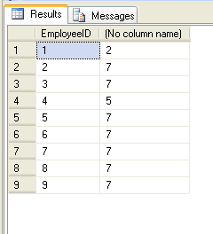
Standard Built-in Functions(Cont.)
NULLIF
  NULLIF expression syntax
  NULLIF ( L, R ) The NULLIF expression is very similar to the CASE expression.
  For example: NULLIF(V1,V2) is equivalent to the following CASE expression
  CASE WHEN V1=V2 THEN NULL ELSE V1 END
CASE
  CASE expression syntax
  You can place a CASE expression anywhere an expression is allowed. It chooses an expression to evaluate based on a boolean test.
  CASE WHEN booleanExpression THEN thenExpression
    [ WHEN booleanExpression THEN thenExpression ]
    ... ELSE elseExpression
    END
    Example
    SELECT EmployeeID,
    CASE EmployeeID
    WHEN 1 THEN 2
    WHEN 4 THEN 5
    ELSE 7
    END
    From dbo.Employees

Slide 58
Standard Built-in Functions(Cont.)
COALESCE Function
  Returns the first nonnull expression among its arguments.
  Syntax
  COALESCE (expression [...n])
  SELECT COALESCE('2010-02-05', '1900-01-01') AS NewDate
  --returns
  2010-02-05

Slide 59
Standard Built-in Functions(Cont.)
ISNULL Function
  Replaces NULL with the specified replacement value.
  Syntax:
  ISNULL (check_expression, replacement_value)
  SELECT ISNULL('1989-02-05', '1900-01-01') AS NewDate;
  --returns
  1989-02-05

Slide 60
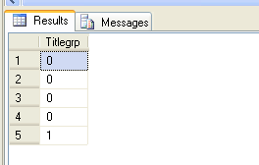
Standard Built-in Functions(Cont.)
Grouping Function
  IT Is an aggregate function that causes an additional column to be output with a value of 1 when the row is added by either the CUBE or ROLLUP operator, or 0 when the row is not the result of CUBE or ROLLUP.Grouping is allowed only in the select list associated with a GROUP BY clause that contains either the CUBE or ROLLUP operator.
  Syntax: GROUPING (column_name)
  SELECT GROUPING(Title) 'Titlegrp'
  FROM dbo.Employees
  GROUP BY Title
  With rollup;
  --Returns

Slide 61
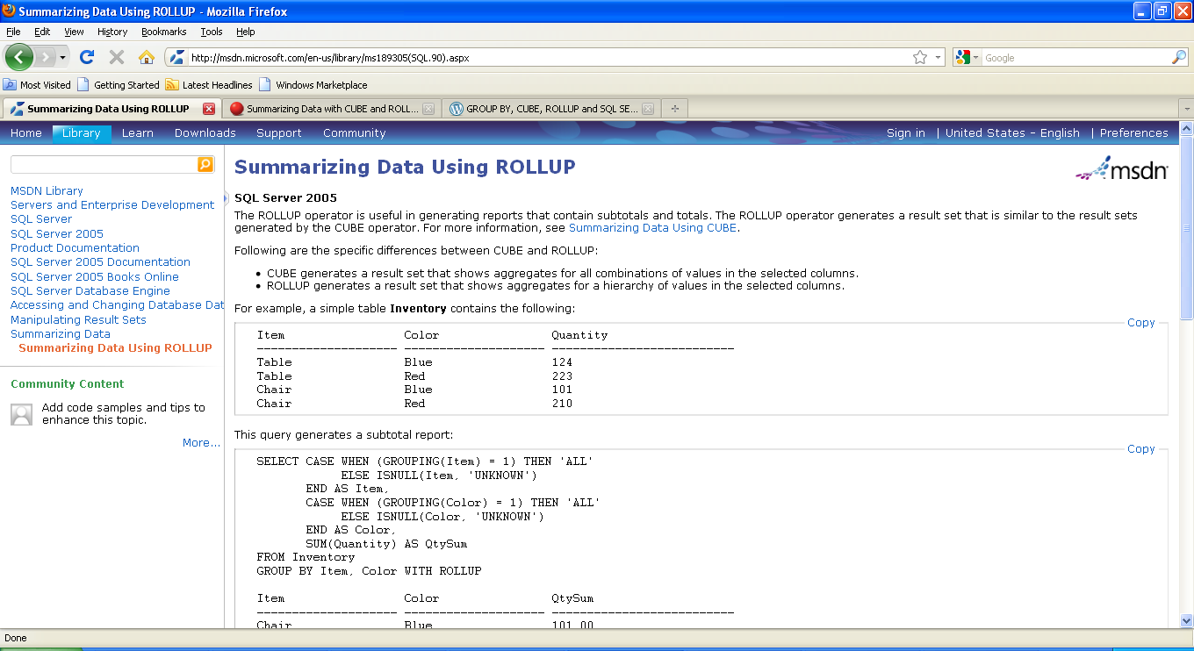
Standard Built-in Functions(Cont.)

Slide 62
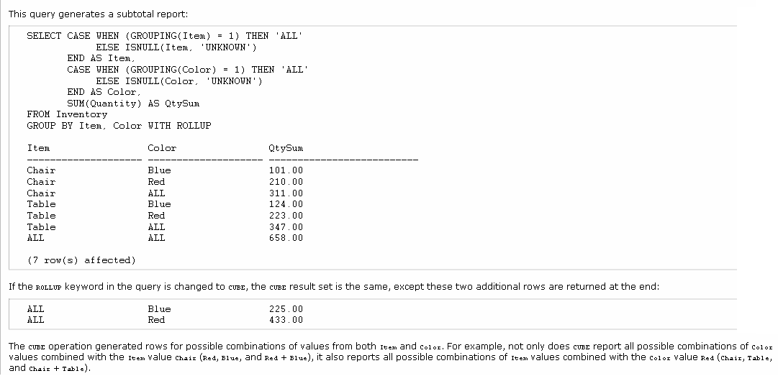

Slide 63
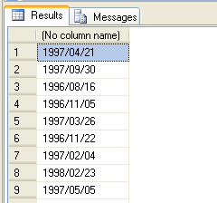
Standard Built-in Functions(Cont.)
Convert Function
  Convert Data into the specific format.
  Syntax
  Convert (Datatype,Fieldname,Format)
  SELECT Distinct convert(varchar,OrderDate,111)
  From dbo.Orders;
  --returns

